Slide 1

Presentation:
ABC of IoT
&
Proposed IoT Project

Slide 2
Contents?
【 01 】 What is IoT?
【 02 】 High Level components
【 03 】 Proposed IoT Project
【 04 】 IoT Device Management: Multi-Platform Web Portal

Slide 3
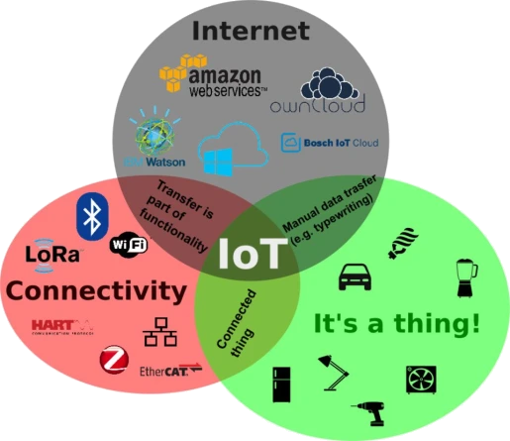
What is IoT?
In layman term, the concept of combining computers, sensors, and networks to monitor and control devices.
Berif Explanation...

Slide 4
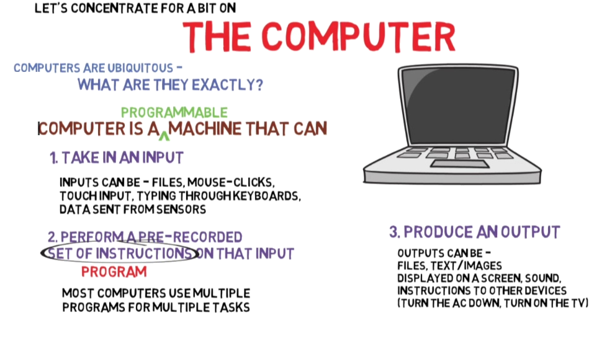
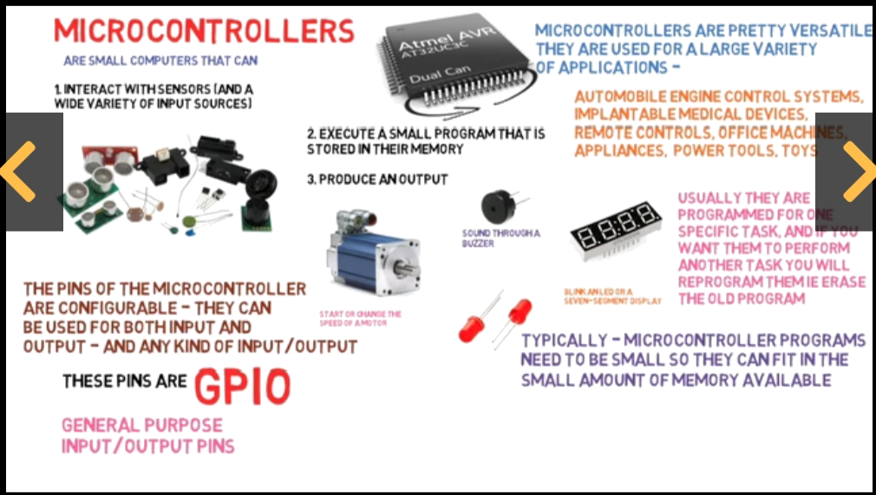
Computers and IoT?
Not a Smart Devices
Microcontrollers makes a Devices Smart

Slide 5
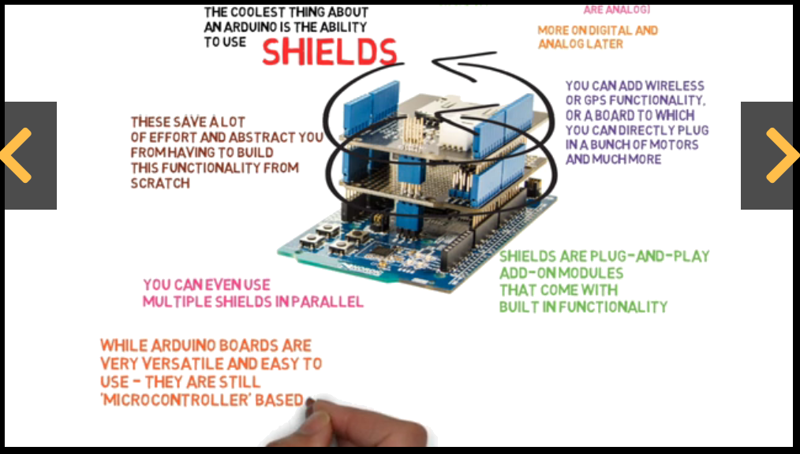
Experimental Boards for R & D?
Adrino and Raspberry Pi....

Slide 6
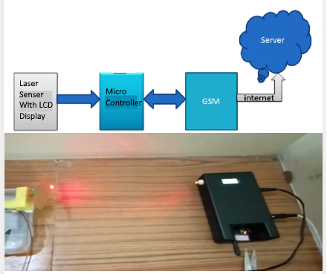
Project Workflow?
Proposed IoT Project....
Html 5 & CSS
Latest web technologies
Relational Database
DB Connectivity
Backend Services
Agile 1 week Sprints
Simulated Unit Testing
Web Portal
Counter Device
(College Library Footfall )

Slide 7
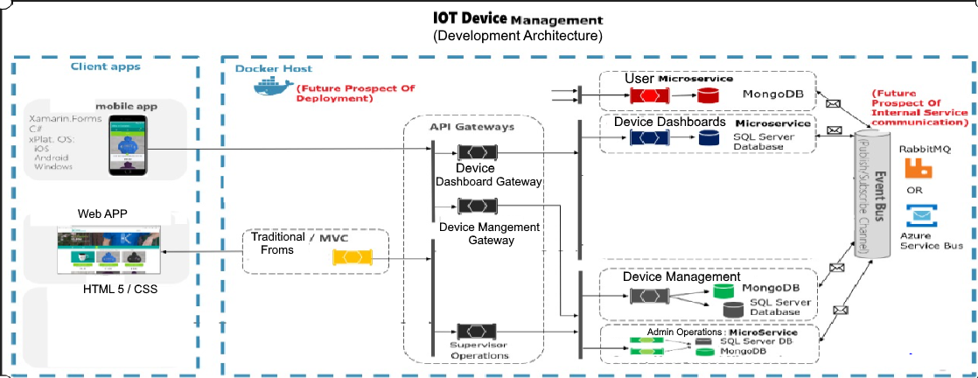
e.g. Architecture of IOT Web Portal!!
Micro-Service Architecture

Slide 8

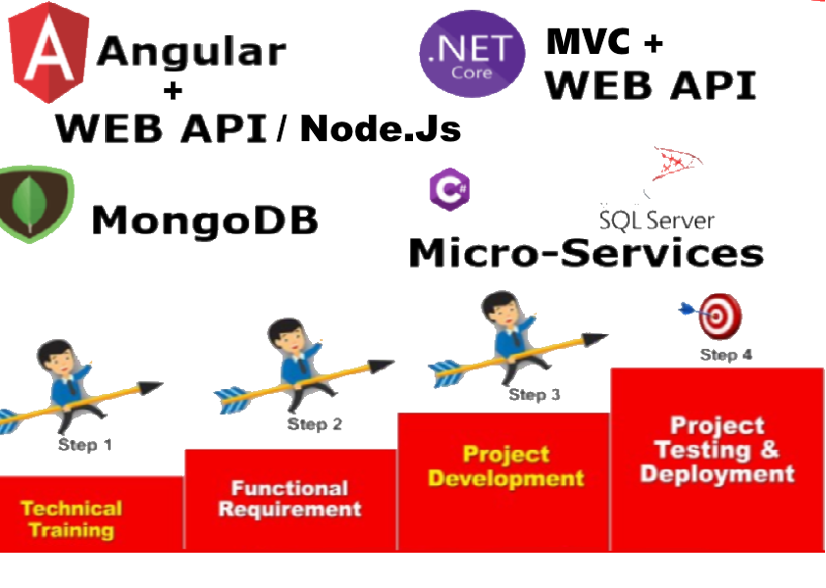
Technology and SDLC

Slide 9
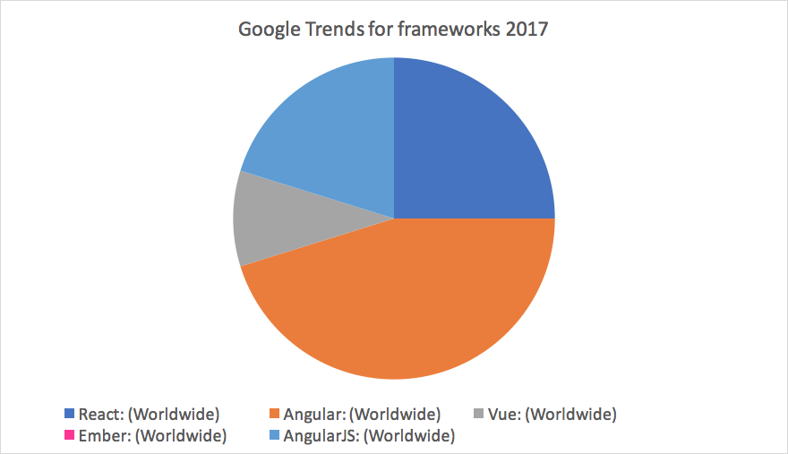
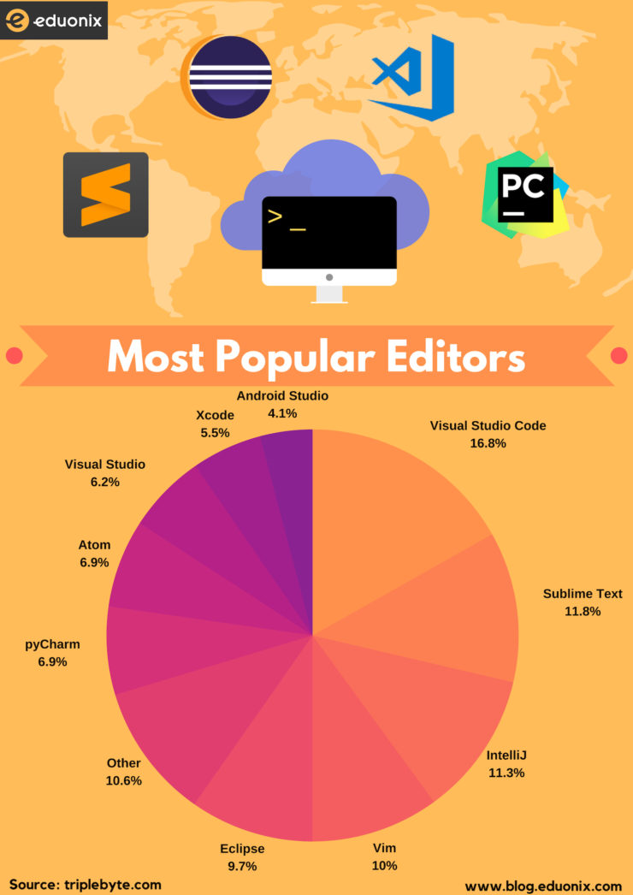
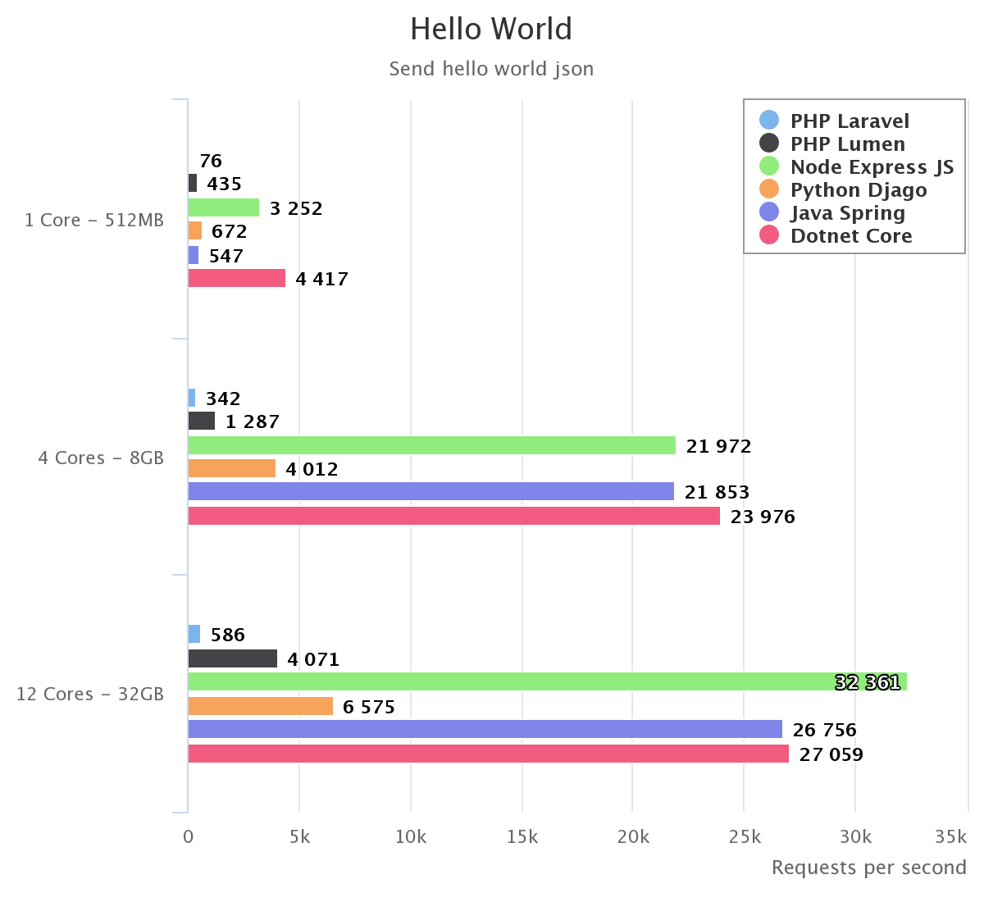
1) Increase in overall placement percentage up to 25%
2) 25-30% students should be placed in higher salary bracket for fresher's(3.5 to 4 LPA)
3) Free Live Project based internship prigram for selected students in final semester of MCA.
4) Nominal cost for internship program for other enrolled participants
5) Paid bootcamps for non enrolled participants with nominal fee.
Exposer Of Tools And Technologies
Notes:
1) Increase in overall placement percentage up to 25%
2) 25-30% students should be placed in higher salary bracket for fresher's(3.5 to 4 LPA)
3) Free Live Project based internship prigram for selected students in final semester of MCA.
4) Nominal cost for internship program for other enrolled participants
5) Paid bootcamps for non enrolled participants with nominal fee.

Slide 10
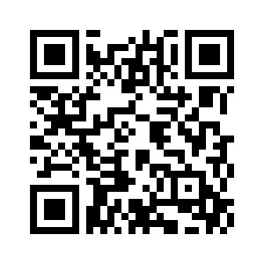
Thank You!!
Scan and Submit your feedback
Connect With Us:
Email: c2c@pinetrainingacademy.com
info@picstrainingacademy.com
Whatsapp: +91 9015666644
www.pinetrainingacademy.com
www.picstrainingacademy.com

